Slide 1
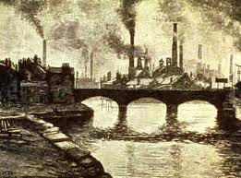
A New Industrial Age
The Expansion of Industry

Slide 2
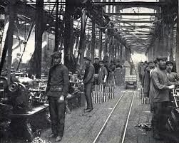
Natural Resources Fuel Industrialization
By the 1920’s, only 60 years after the Civil War, the U.S.A was the leading industrial power in the world.
How did this happen?
Wealth of Natural Resources
Government Support for
Business
Growing Urban Population

Slide 3
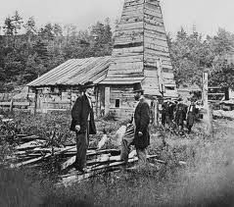
Discoveries/Inventions: Black Gold
Black Gold:
1840-1860: Oil used for kerosene to light lamps
1859: Edwin L. Drake-used a steam engine to drill for oil which started an oil boom.
Eventually used for gasoline

Slide 4
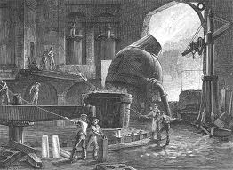
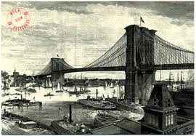
Discoveries: Bessemer Steel Process
Removed carbon from Iron to create Steel
Steel used to make:
Skyscrapers
Bridges
Railroads
Barbed Wire
Steel Plow

Slide 5
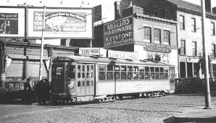
Invention: The Light Bulb
The Power of Electricity
1880 Thomas Edison patented the light bulb
He later invented a system for distributing electric power which led to:
Fans
Streetcars: Urban Travel
New Locations for
Manufacturing Plants
In Home:
Electronic appliances

Slide 6
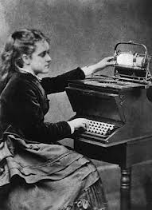
Invention: Typewriter
Christopher Sholes
Invented the Typewriter
Seen as a woman’s job
More women in the workforce
Secretary/Newspapers

Slide 7
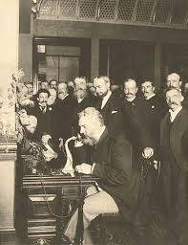
Invention: The Telephone
Alexander Graham Bell
Telephone
Opened the door for worldwide communication
New jobs for women

Slide 8
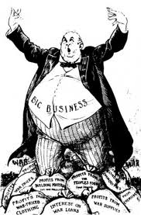
Social Darwinism
Social Darwinism: Developed from Charles Darwin’s theory of biological evolution
Natural Selection and Survival of the Fittest
Justified Laissez-faire (allow to do) which meant the marketplace should not be regulated-government shouldn’t intervene
Appealed to the Millionaires and the Protestant work-ethic:

Slide 9
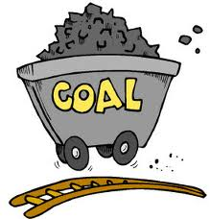
Horizontal and Vertical Integration
Resources
Raw Materials, fields, forests, and farms
Manufacturing
Production and processing
Distribution
Shipping and transportation, delivery to customers

Slide 10
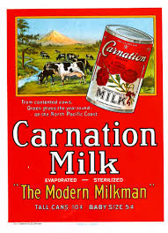
ADVERTISEMENT
In the box provided on your notes you are going to make an advertisement for one of the new products/ inventions created during this time period. (You want people to buy it!)
You need to name the product
You need to mention the benefits
You need an image (should be colorful and eye catching)
You can choose: Steel, Barbed Wire, Telephone, Light bulb, Electricity, typewriter, Oil, etc.

Slide 11
Definitions
Captains of Industry: A business leader whose means of gaining wealth contributes positively to the country in some way. (Increased productivity, more jobs, expansion of markets, philanthropy, etc)
Robber Barons: a disparaging term used to describe a powerful 19th century businessman who used questionable and unethical practices to become powerful and wealthy.

Slide 12
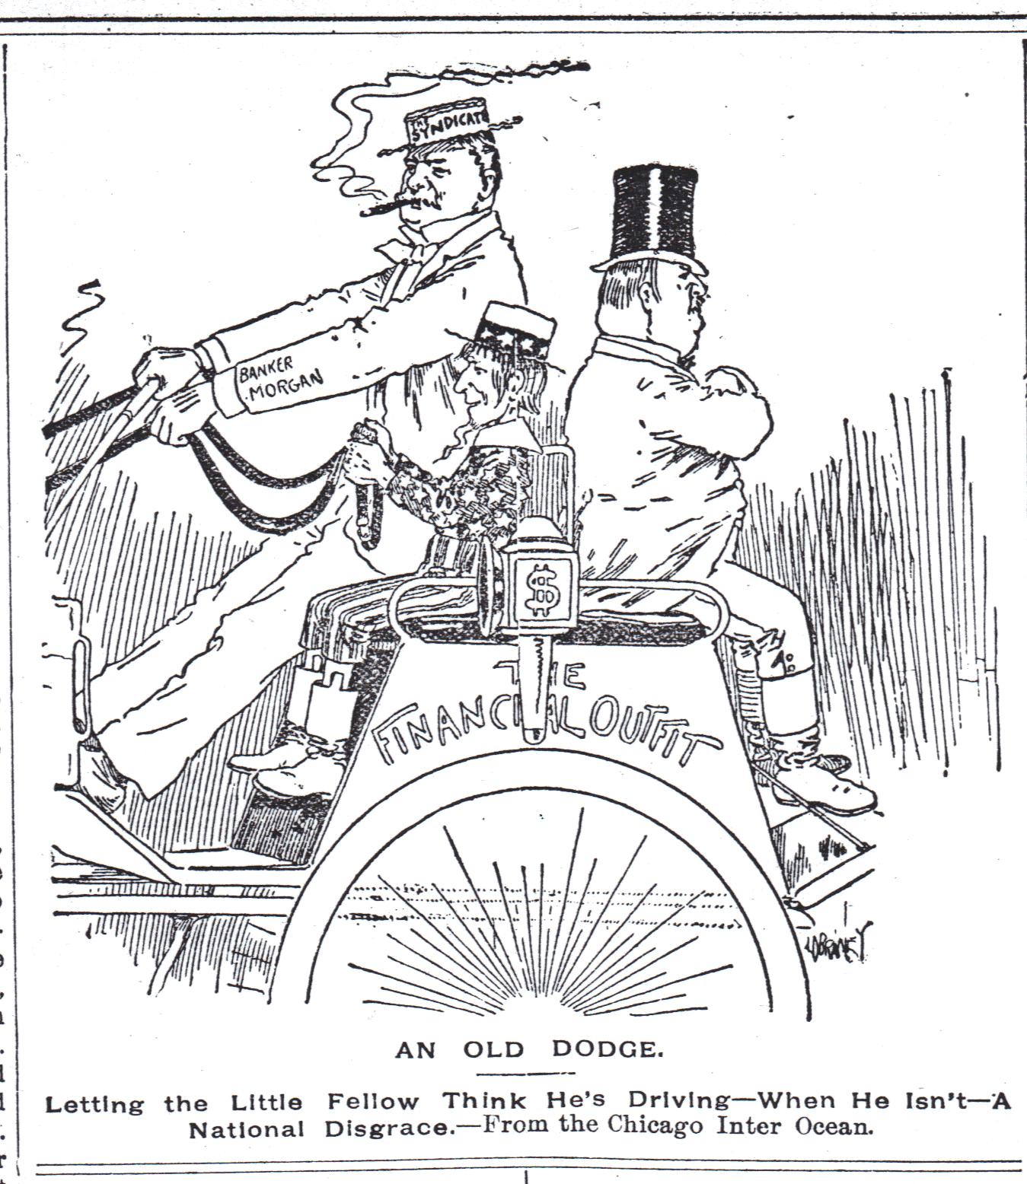

Slide 14
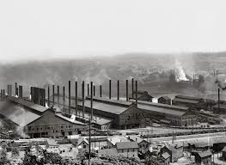
Big Business and Labor
The Rise of Industrial Moguls
Andrew Carnegie: Immigrant from Scotland- Rags to Riches
Developed the Carnegie Steel Company which, by 1899 manufactured more steel than all the factories in Great Britain
It succeeded because of his management process
New Machinery
Accounting Systems to keep track of prices
Encourage Competition
Attracted people by offering them stock in the company

Slide 15
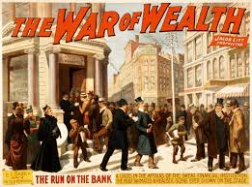
Panic and Consolidation
Corporate Abuse, mismanagement, Overbuilding, and Competition pushed many railroads into bankruptcy
The Panic of 1893 allowed financial companies like JP Morgan and Company to reorganize and gain control of the railroads.

